Slide 1

Home
About
Contact
CAR ANALYSIS PROJECT

Slide 2

Home
About
Contact
DESCRIPTION
Observations: 11,159 entries.
Variables: 16 features, including ‘Make’, ‘Model’, ‘Year’, ‘Horsepower’, ‘Fuel Type’, ‘MPG’, ‘Market Category’, and ‘MSRP’.

Slide 3
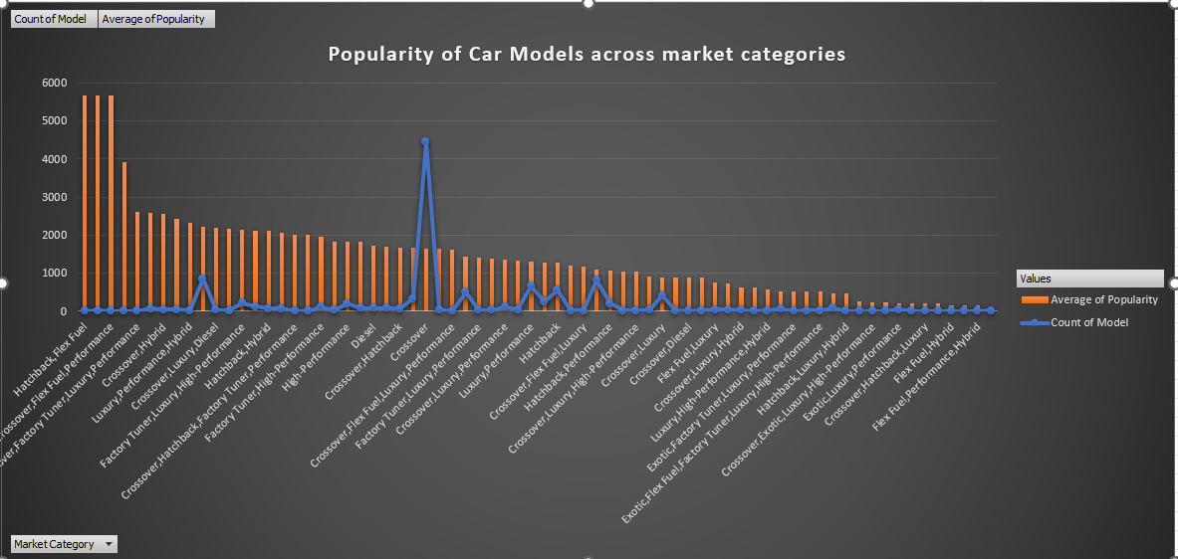
Task 1: Popularity of car models across market categories.
Combination Chart combining a clustered column and a line chart.
Crossover has the most number of models with the value of 4440

Slide 4
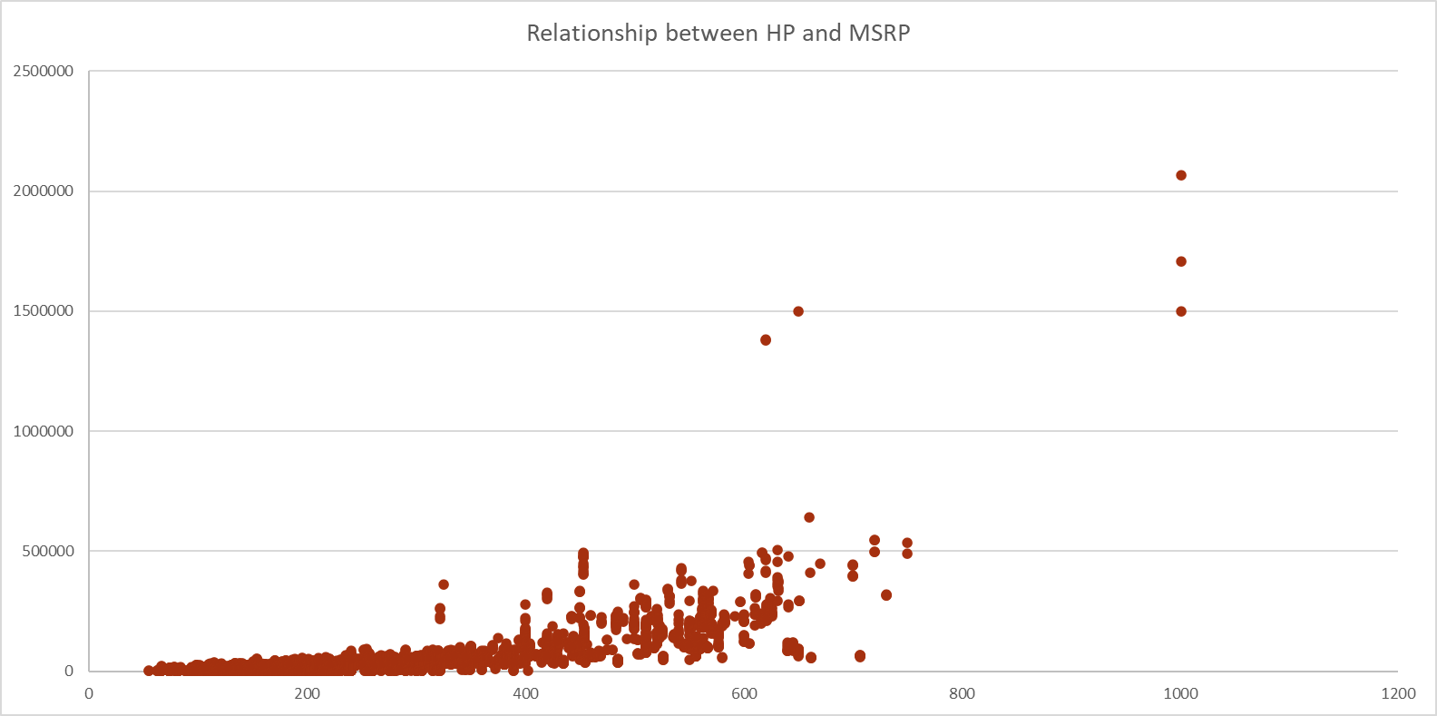
Task 2: Relationship between engine power (HP) and price (MSRP).
Scatter Flow Chart

Slide 5
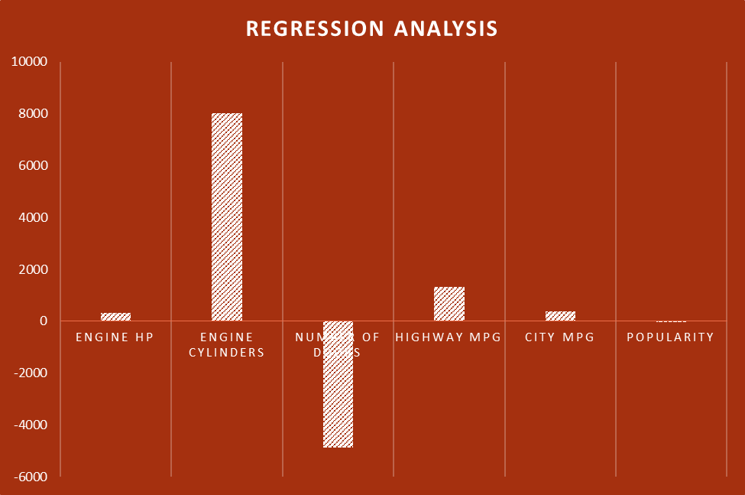
Task 3: Features affecting price.
Clustered column chart.
Engine Cylinders with the highest while Number of doors with the lowest regression value.

Slide 6
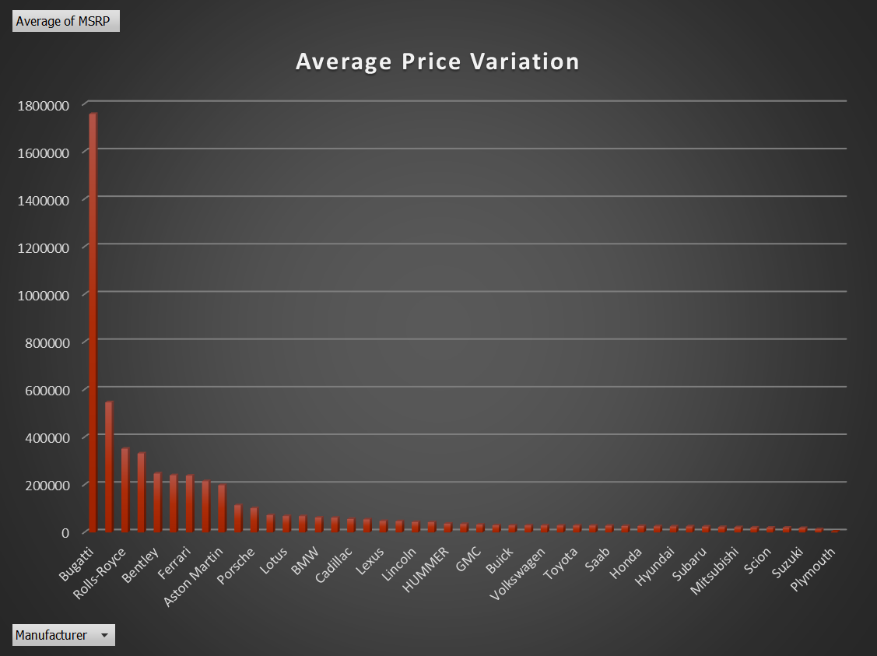
Task 4: Average price variation by manufacturer.
3-D Clustered column chart.
Bugatti and Rolls-Royce lead the average pricing in the market.

Slide 7
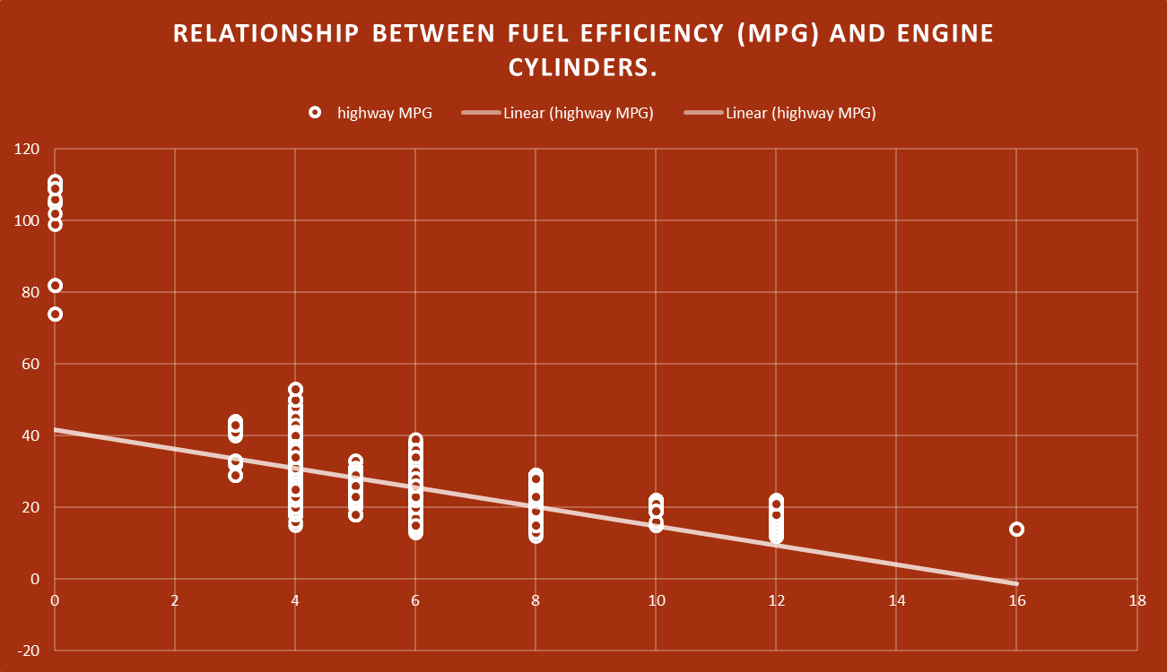
Task 5: Relationship between fuel efficiency (MPG) and engine cylinders.
Scatter chart.

Slide 8
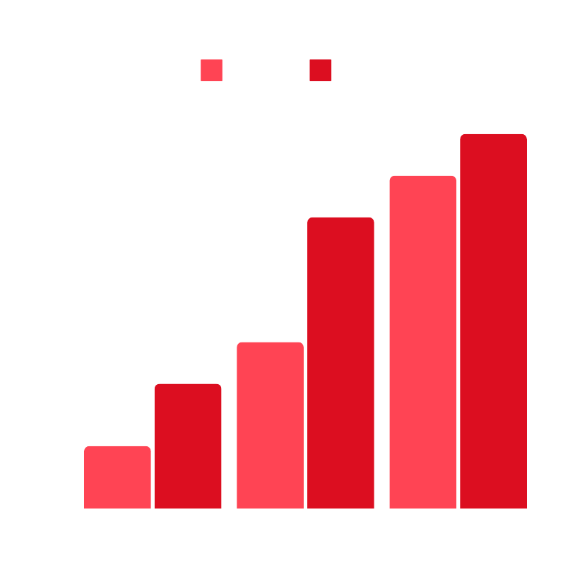
Home
About
Contact
DASHBOARD TASKS

Slide 9
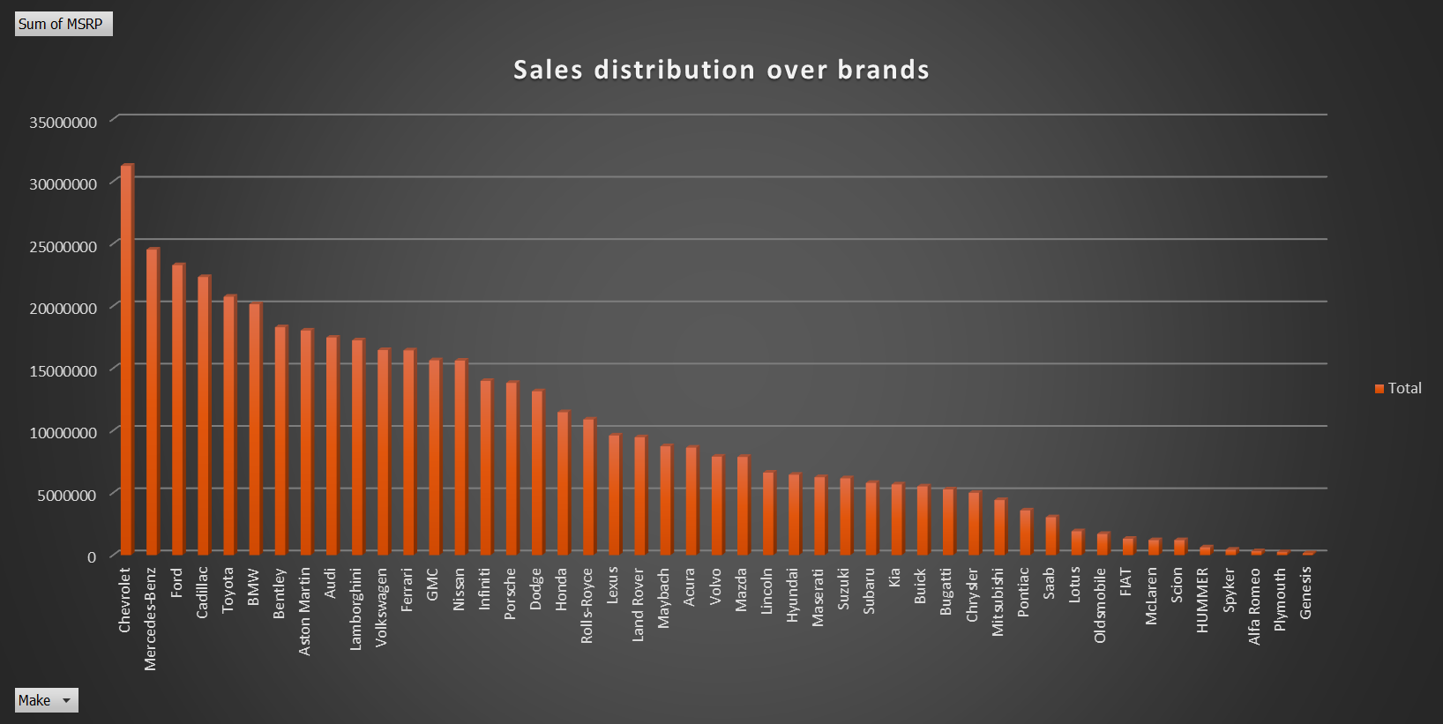
Task 1: Distribution of car prices by brand and body style.
3-D Clustered column chart.
Chevrolet has the highest Sales distribution of 31252763

Slide 10
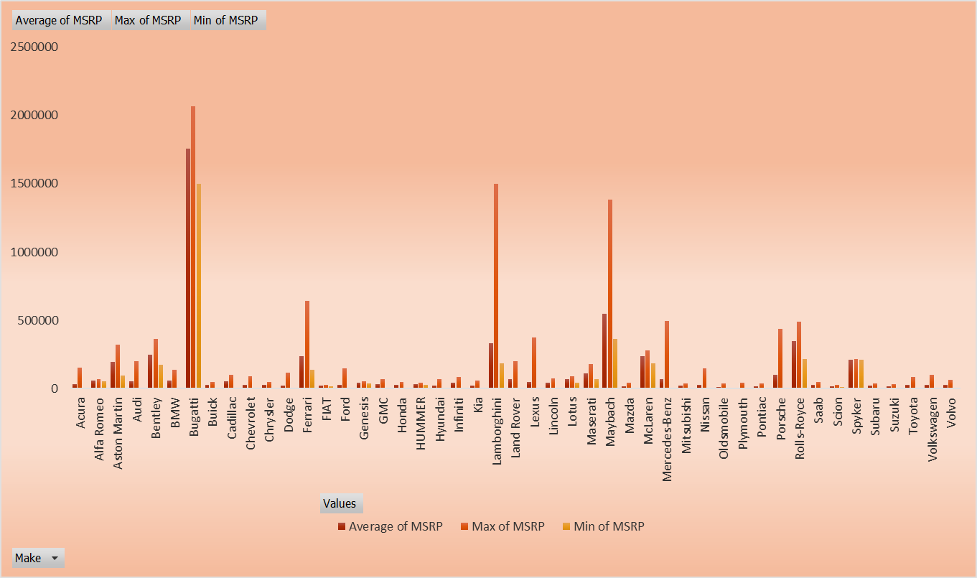
Task 2: Brands with the highest and lowest average MSRPs by body style.
Clustered column chart.
Chevrolet has the highest Sales distribution of 31252763

Slide 11
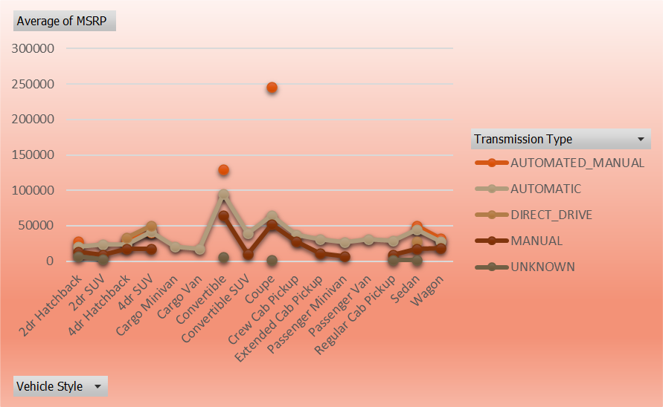
Task 3: Effect of transmission type on MSRP by body style.
Stacked Line chart with markers

Slide 12
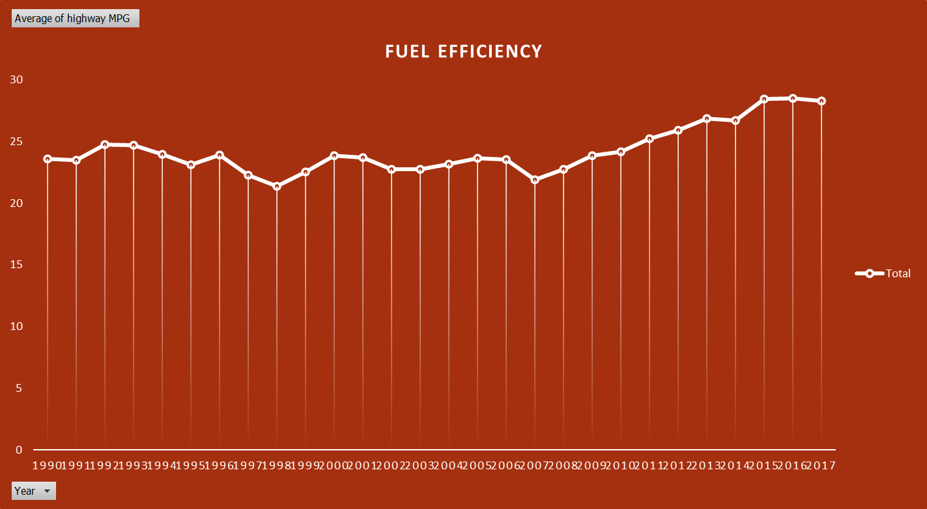
Task 4: Fuel efficiency trends by body styles and model years.
Line chart with markers

Slide 13
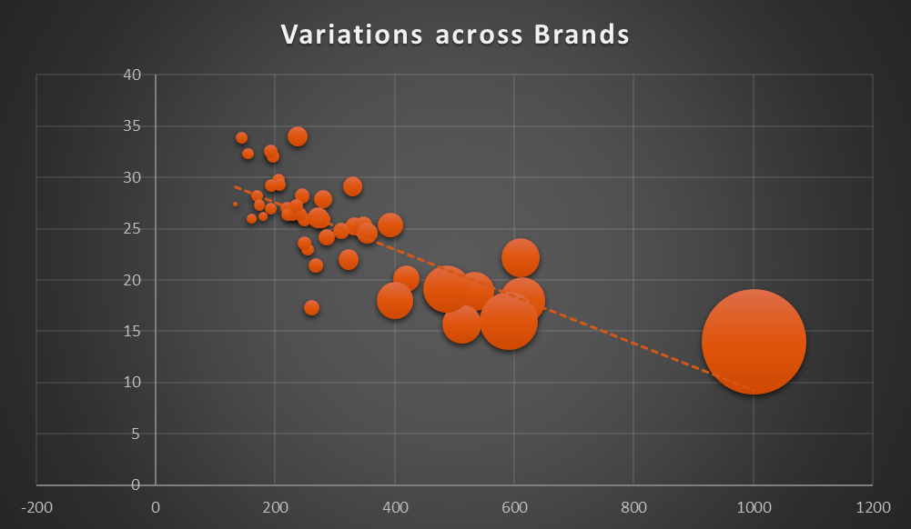
Task 5: Variations in horsepower, MPG, and price across brands.
Bubble Chart

Slide 14
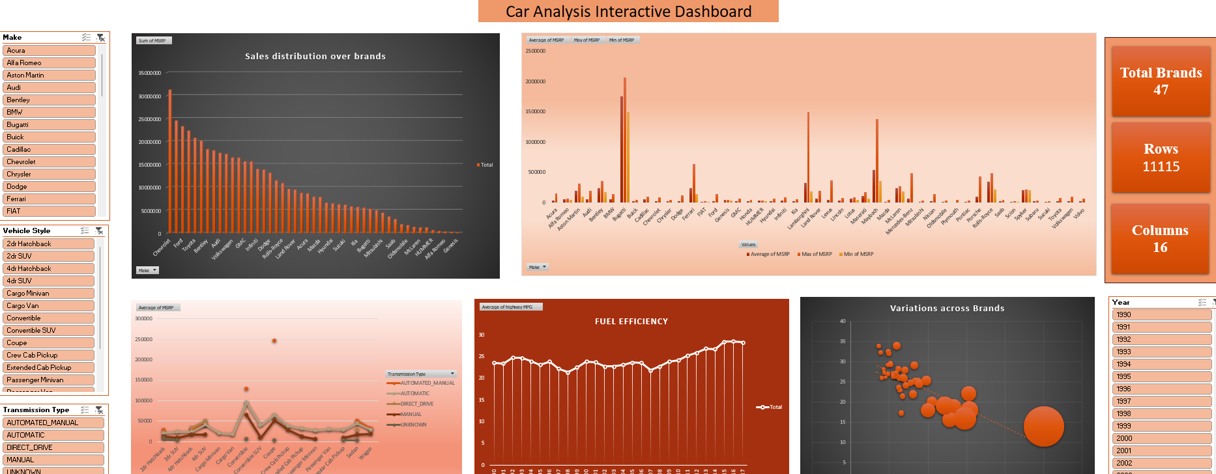
Dashboard

Slide 15
Home
About
Contact
INSIGHTS SUMMARY
Popularity Insights: Luxury and SUVs are consistently popular market categories.
Horsepower and Price: Strong positive correlation; higher HP vehicles demand premium pricing.
Price Drivers: Engine HP, fuel type, and luxury category significantly influence MSRP.
Manufacturer Pricing: Premium brands like BMW and Mercedes dominate high average MSRP segments.
Fuel Efficiency: Higher cylinder counts correlate with lower MPG.

Slide 16
Home
About
Contact
RECOMMENDATIONS
Invest in high-HP, fuel-efficient cars for premium pricing.
Focus R&D on improving MPG for SUVs and high-cylinder cars.
Target marketing efforts on popular segments like luxury SUVs.
Expand offerings in low-MSRP segments for emerging markets.

Slide 17


Home
About
Contact
DASHBOARD REVIEW
Interactive Elements:
Filters and Slicers:
Brand, Body Style, Market Category, Year.
Charts:
Combo, Scatter, Bar, Line, and Bubble charts.
Dynamic Updates:
Dropdowns and slicers dynamically update charts.
Features:
Summarized metrics (e.g., average MSRP, top-performing brands).
Clear visual hierarchy for intuitive navigation.
Conditional formatting to highlight key insights.

Slide 18

Home
About
Contact
TOOLS AND TECHNIQUES
Tools Used:
Excel:
Pivot Tables and Charts.
Regression Analysis with Data Analysis Toolpak.
Advanced functions (e.g., CORREL, SLOPE, AVERAGE).
Dashboard Features:
Slicers, dropdowns, conditional formatting, dynamic ranges
Techniques:
Data cleaning and preprocessing.
Regression analysis for feature importance.
Interactive visualizations for user exploration.

Slide 19

Home
About
Contact
SUBMISSION DETAILS
1.)Files Delivered:
Interactive Dashboard in Excel.
Report (PDF/PPT).
2.)Video Presentation:
Explains tasks, methodology, and insights.
Links to Files:
Analysis Folder: [Google Drive Link]
Presentation File: [Google Drive Link]

Slide 20
Home
About
Contact
See You Next
THANK YOU

